Slide 1


Slide 2
Weighted Linde-Buzo-Gray Stippling

Slide 3
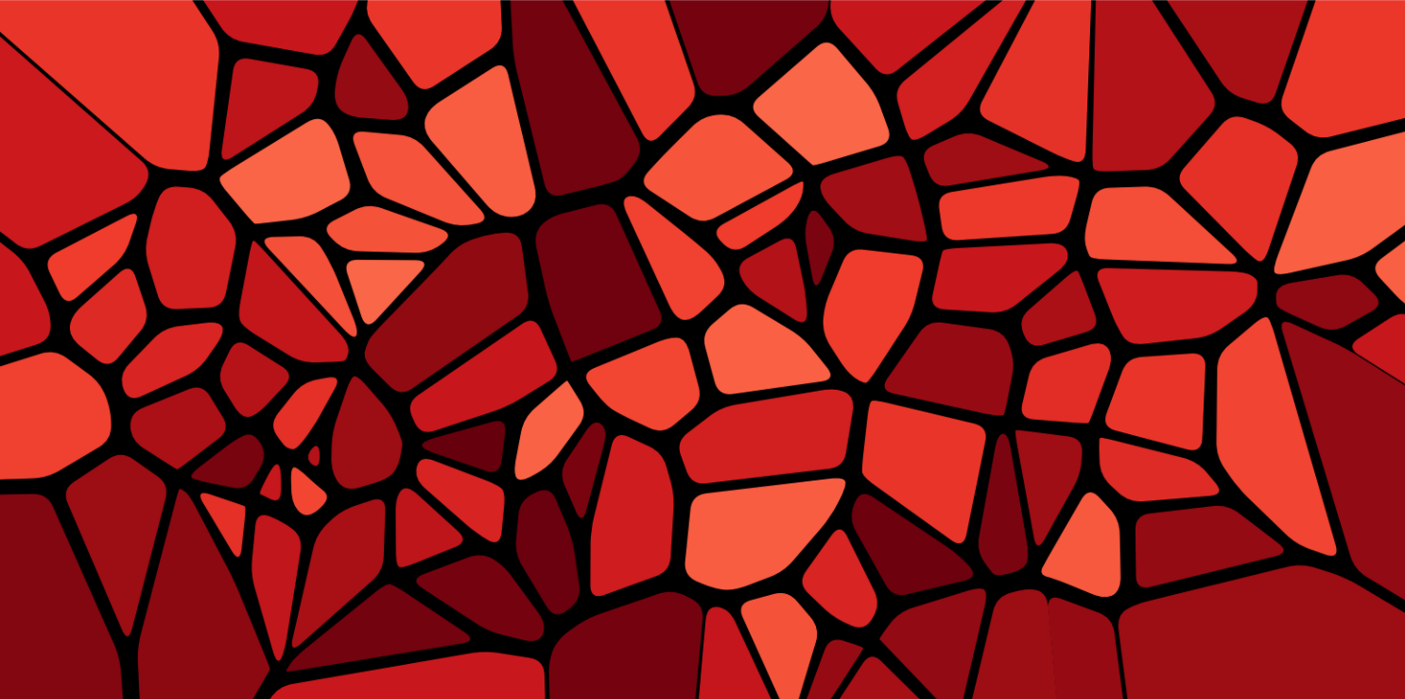
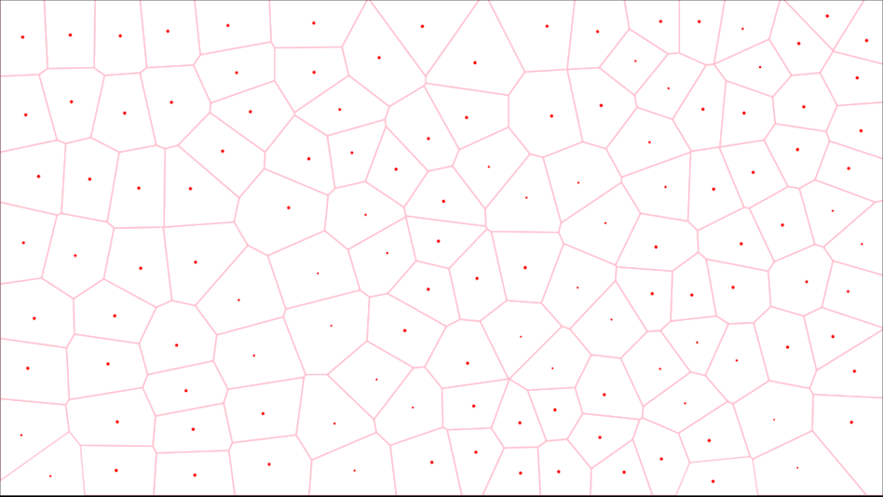
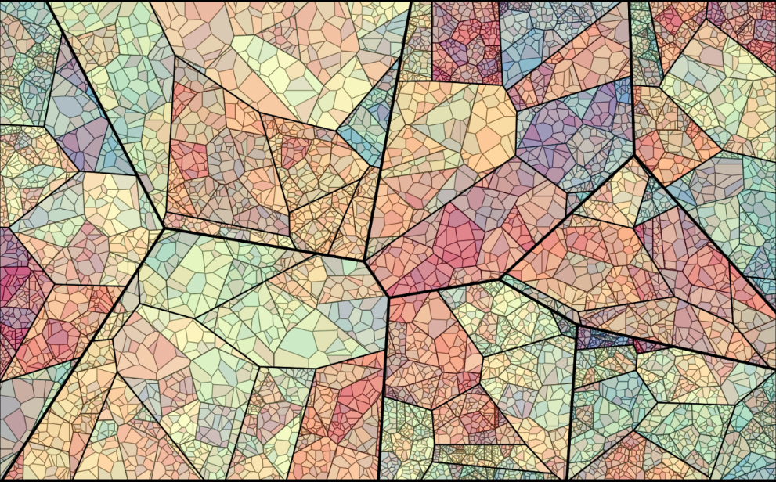

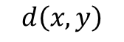
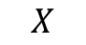
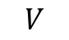
2D Voronoi Diagram
$$V_{k}=\left\{x ∈X \right| d\left(x, p_{k}\right) ≤d\left(x, p_{j}\right) \text{for} \text{all} j ≠k\}$$
$$V$$
Voronoi cells
$$X$$
Set of all points (pixels)
$$d\left(x, y\right)$$
Distance between point x and y
$$p_{i}$$
Site (one of these given points)
Voronoi diagram in visual art

Slide 4
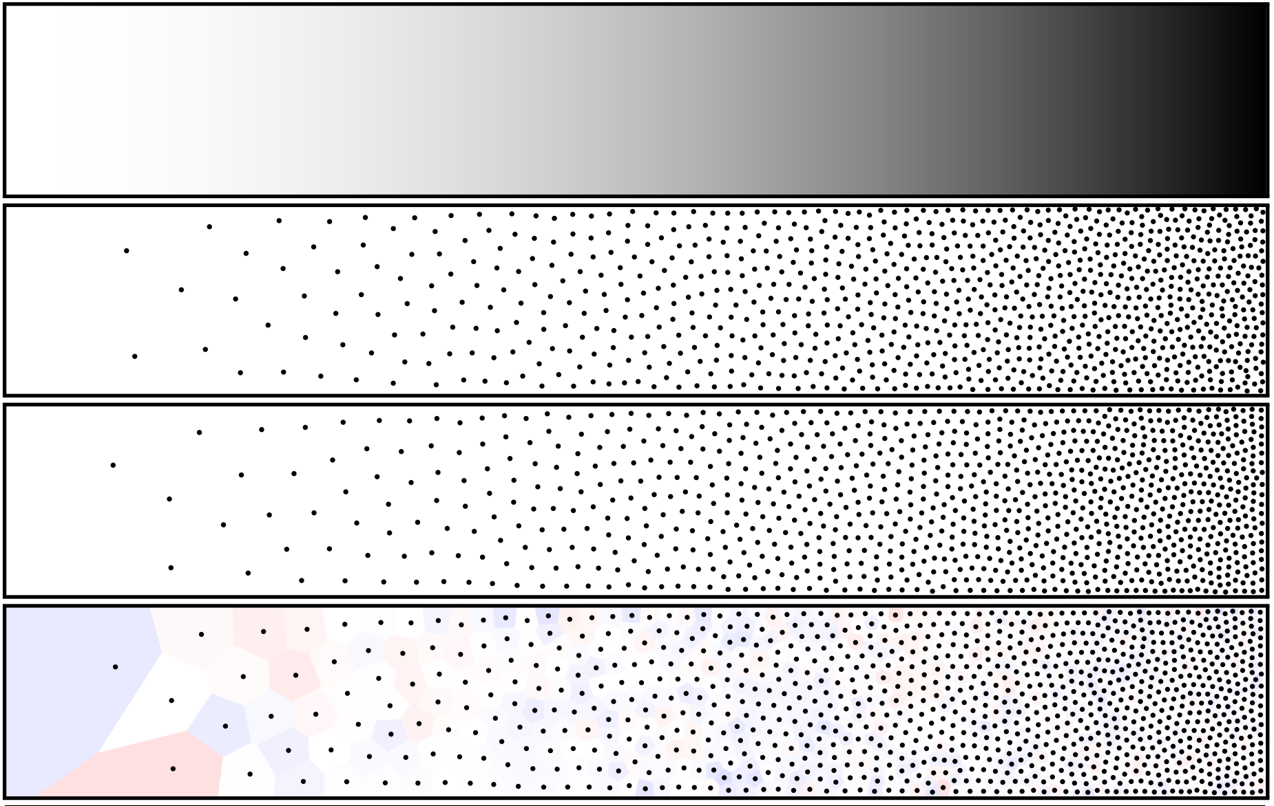
Weighted LBG Stippling
﻿Density
﻿
Compute Corresponding Voronoi Diagram

Slide 5
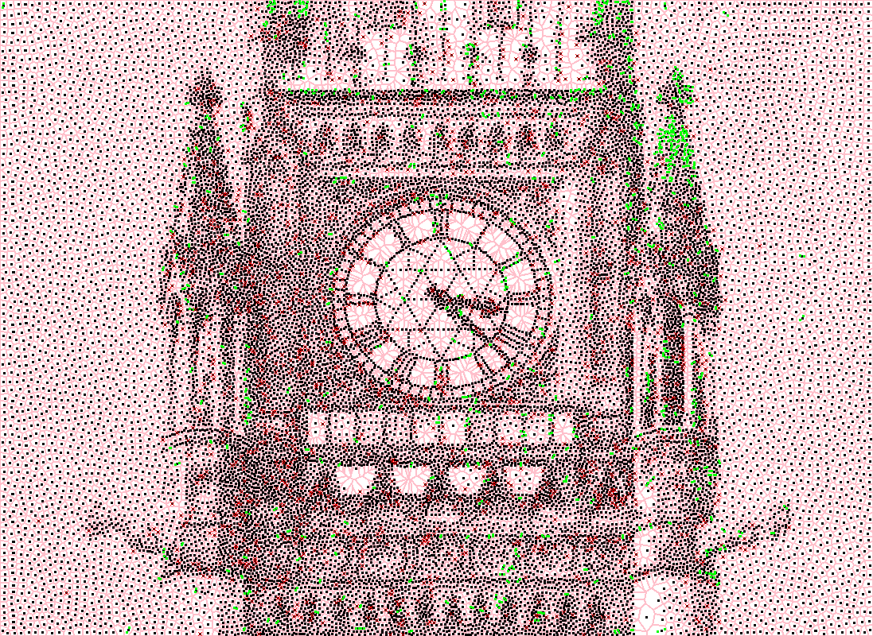
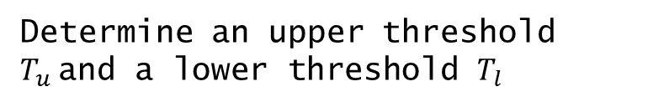
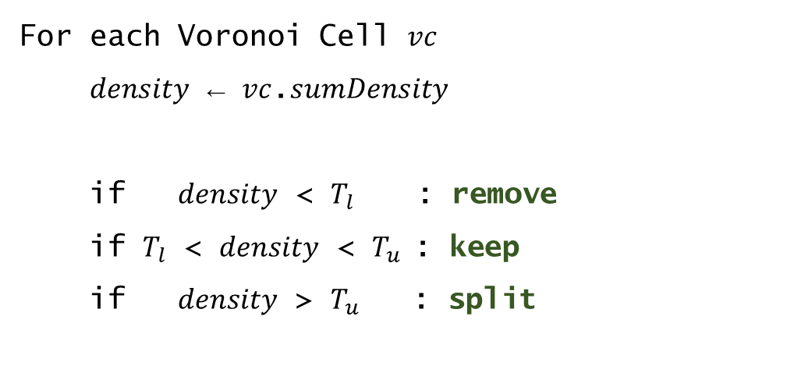
Weighted LBG Stippling
Determine﻿ an upper threshold $T_{u}$and a lower threshold $T_{l}$
﻿For each Voronoi Cell $vc$
$density$ ← $vc$.$sumDensity$
if $density$ < $T_{l}$ : remove
if $T_{l}$ < $density$ < $T_{u} \text{:}$keep
if $density$ > $T_{u}$ : split

Slide 6
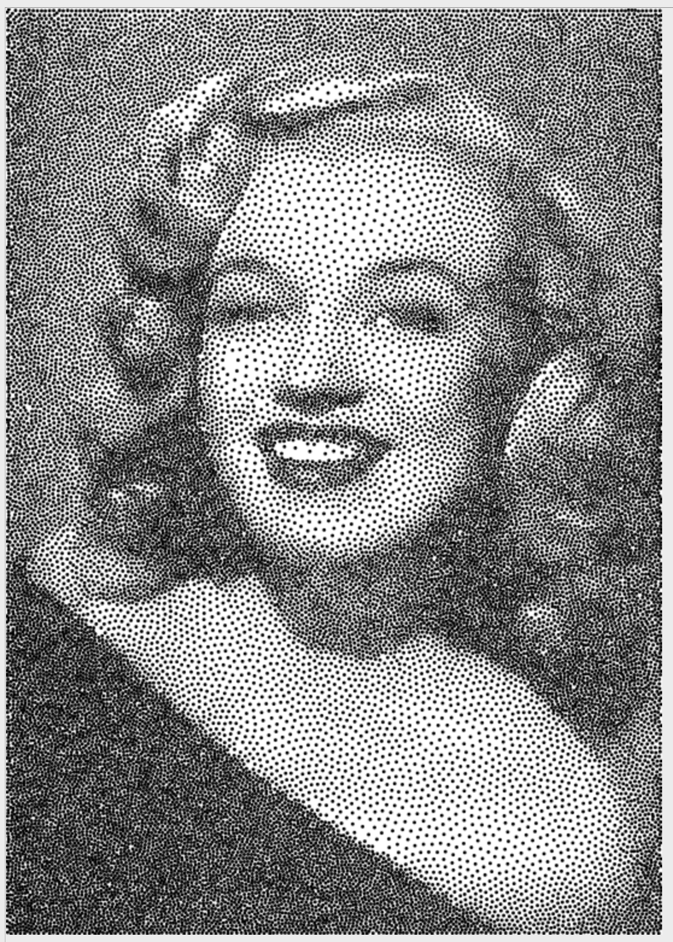
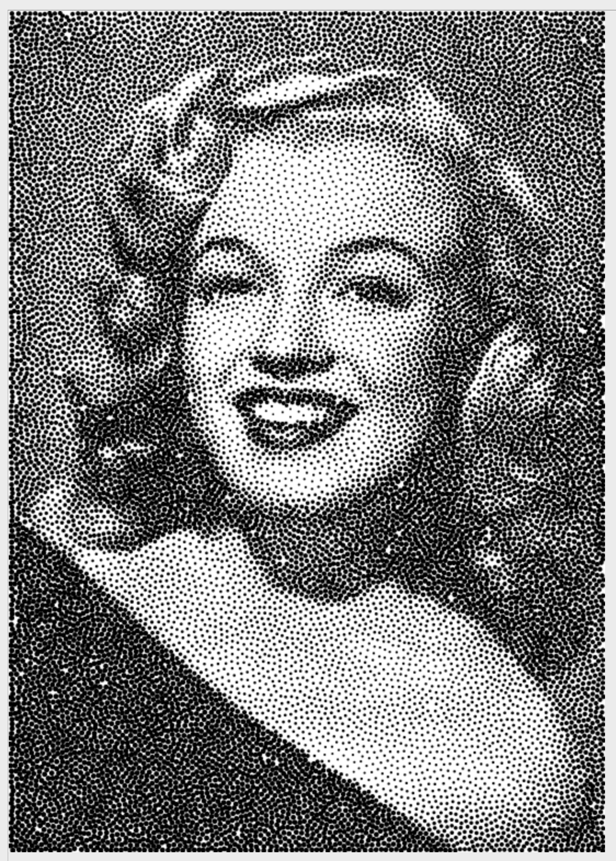
Adaptive Point Sizes
﻿
Before
After

Slide 7
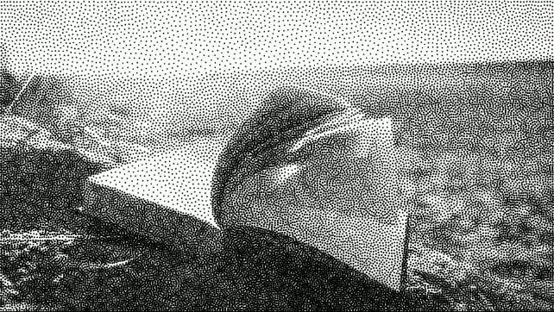
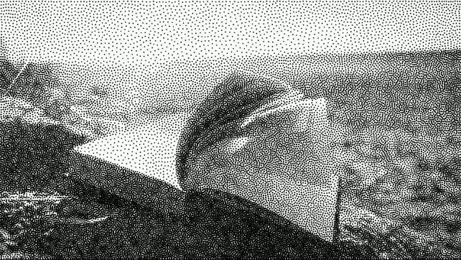
Video Stippling
Stipple each frame
from the beginning
Use last frame’s output
as this frame’s input

Slide 8
Multi-Class Inverted Stippling

Slide 9
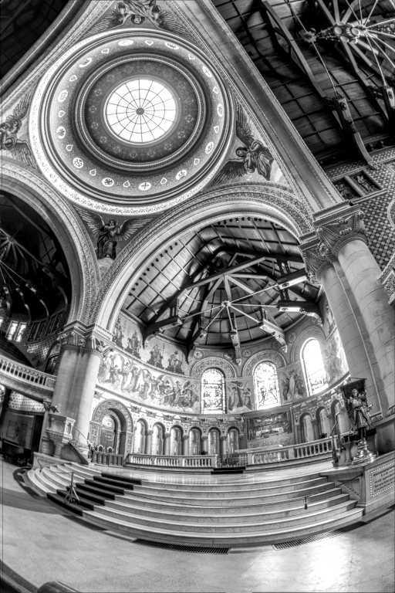
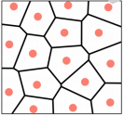
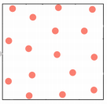
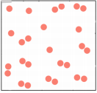
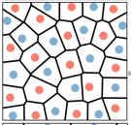
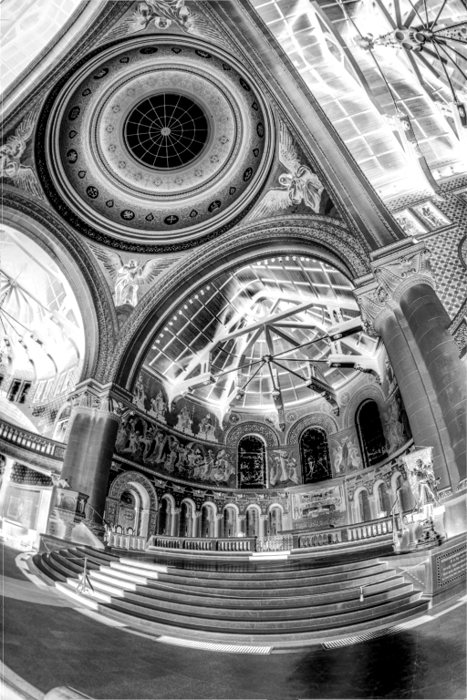
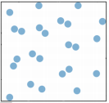
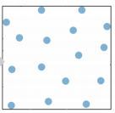
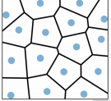
Multi-Class Inverted Stippling
lower-
density
﻿within-class
higher-density
﻿Layer1
cross-class
﻿Init
﻿Update
﻿Layer2
﻿Coupling

Slide 10
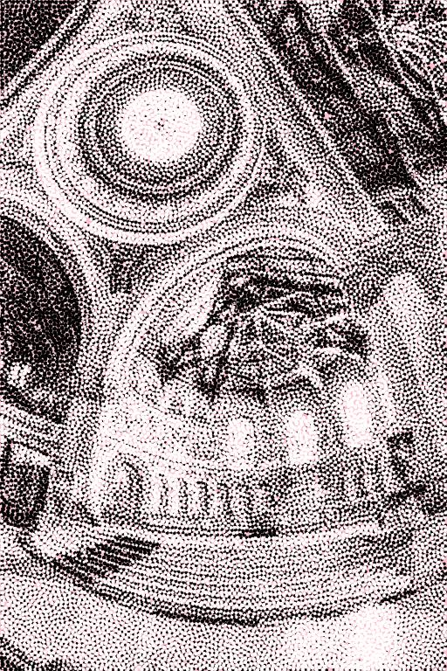
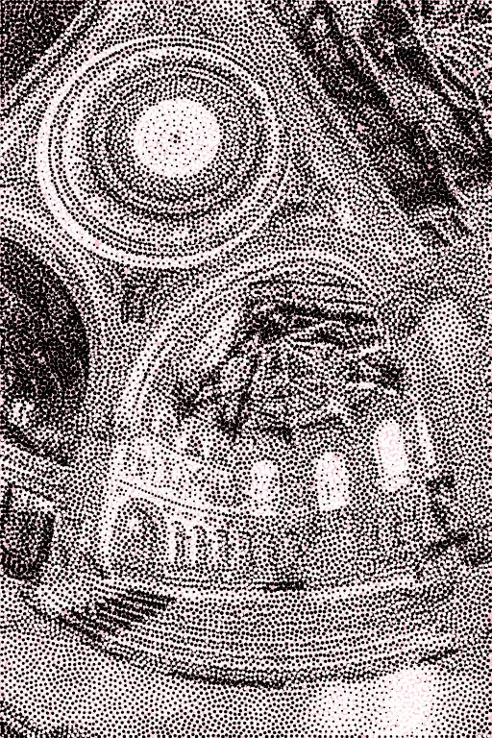
Reordering
Before
After

Slide 11
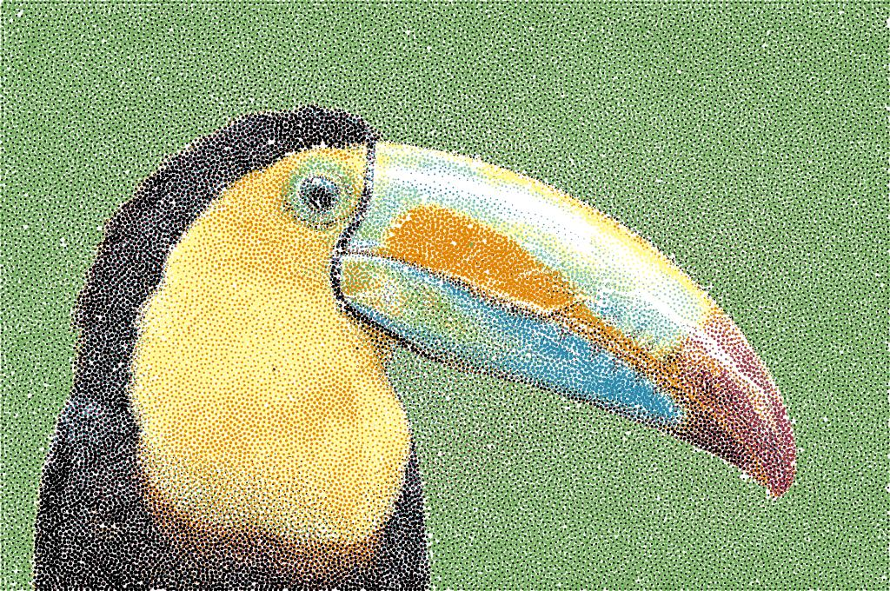
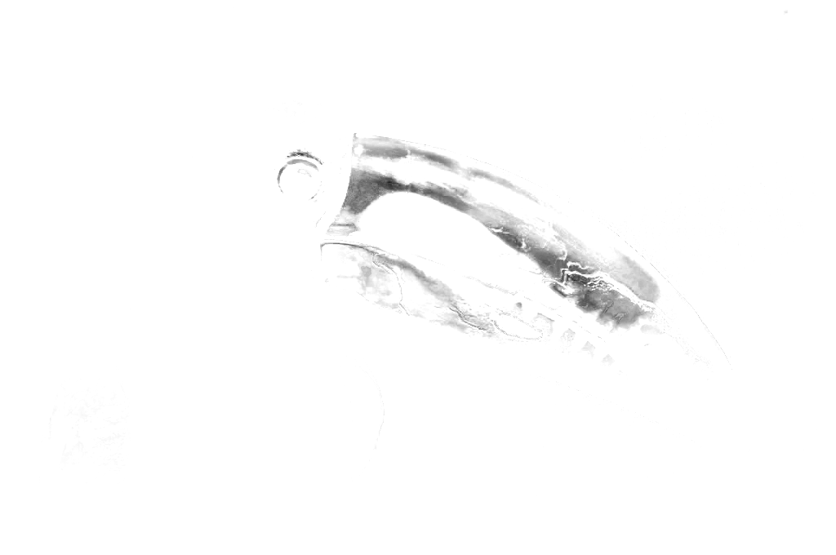
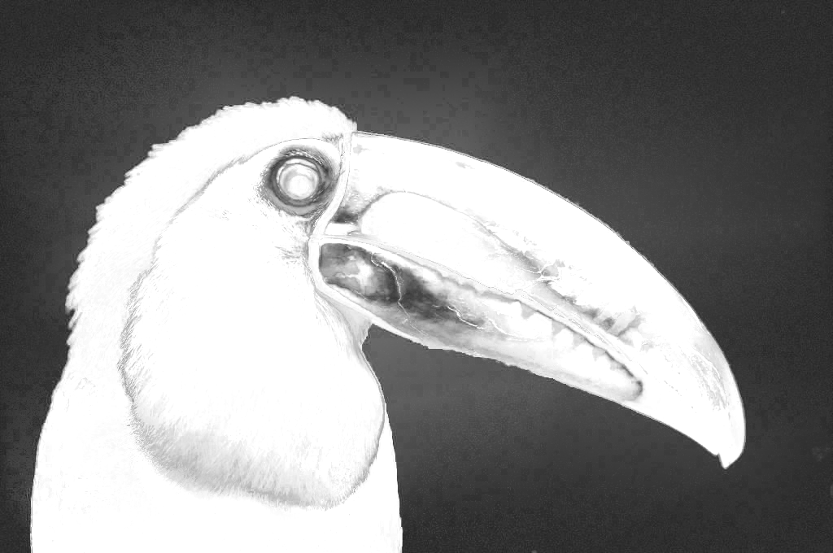

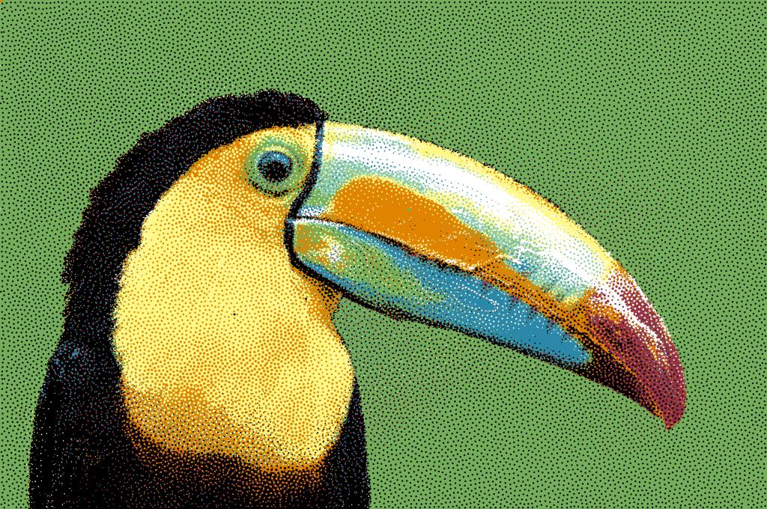
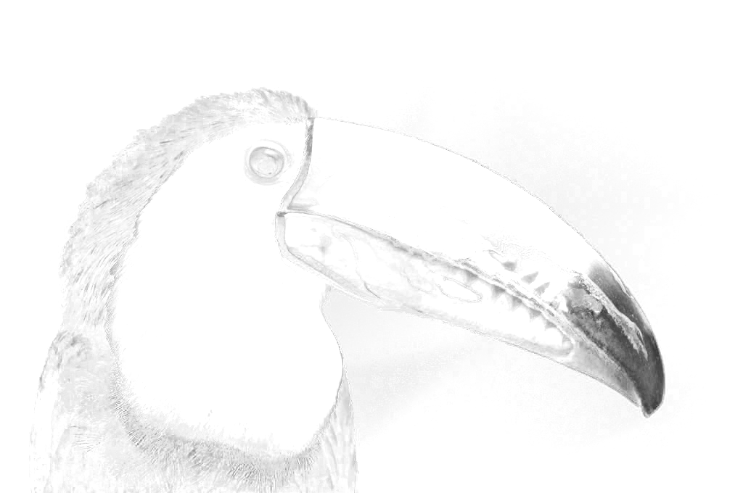
Color Stippling
Ordering
﻿
Palette Extraction
…
Color Decomposition
Filling

Slide 12
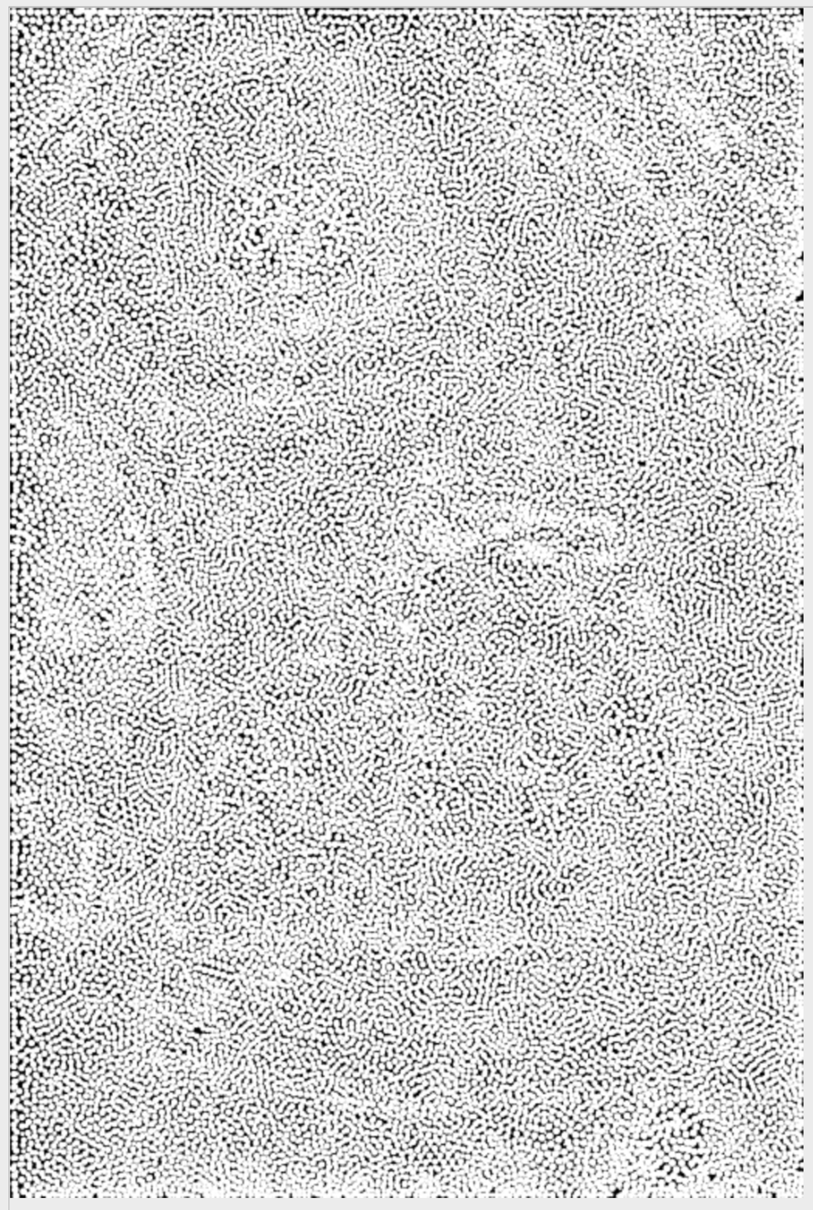
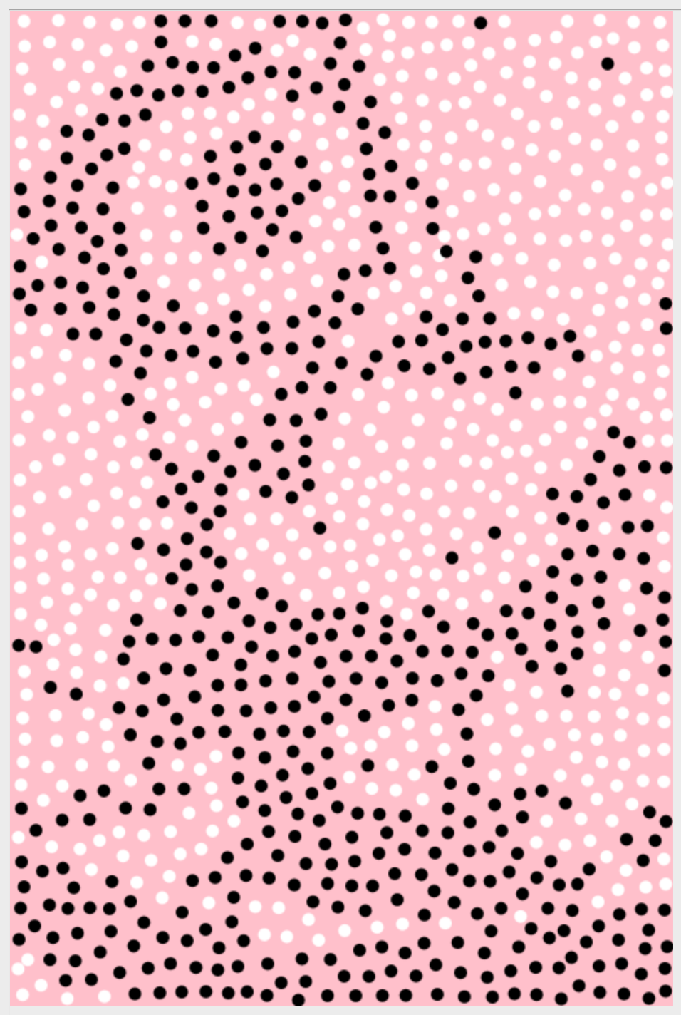
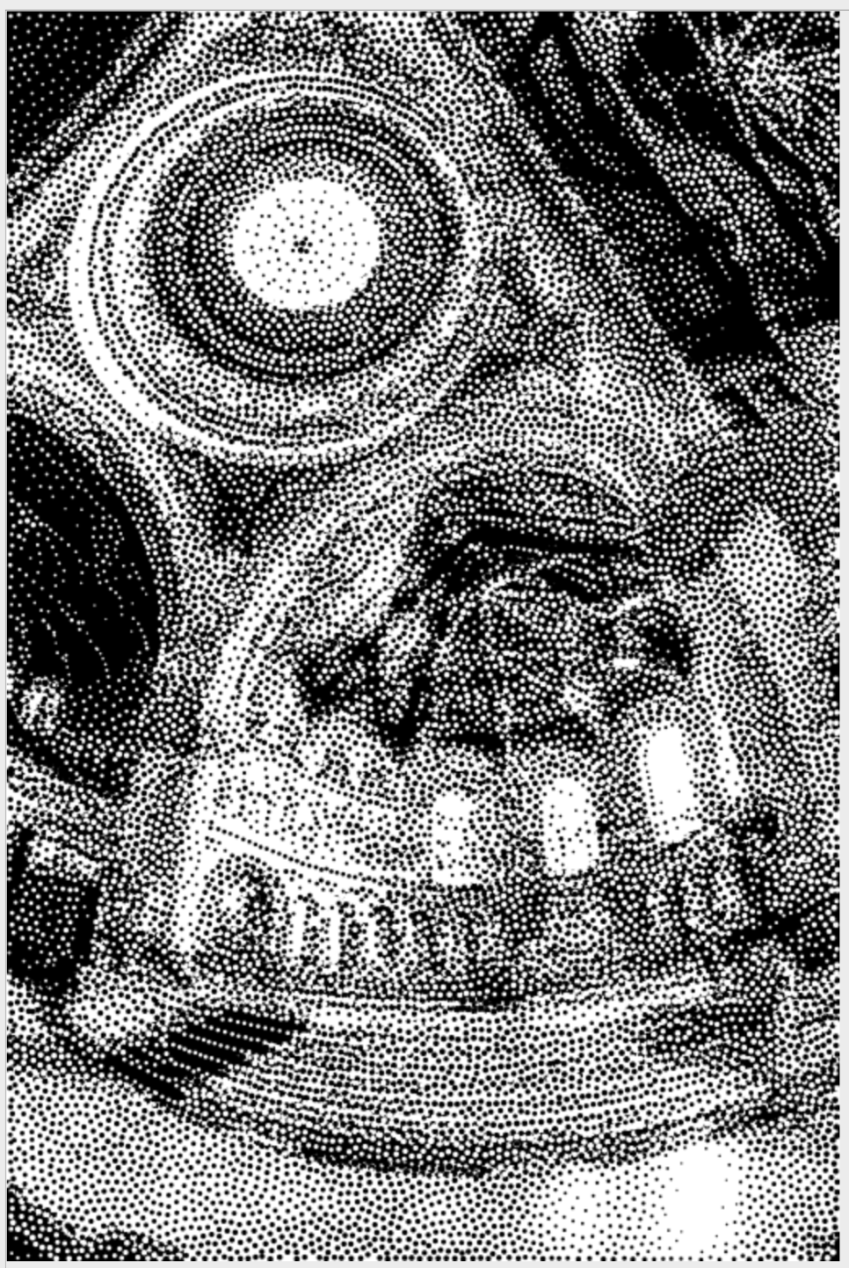
Background Filling
Gap Mask
Run LBG stippling to cover all the gaps

Slide 13
Reconstruction

Slide 14
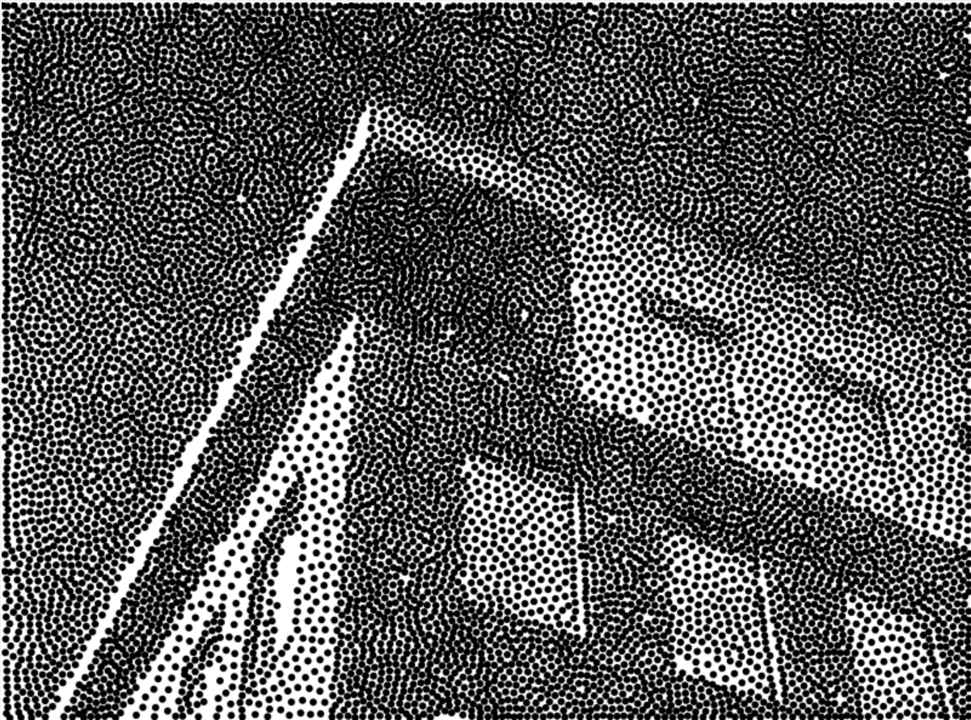
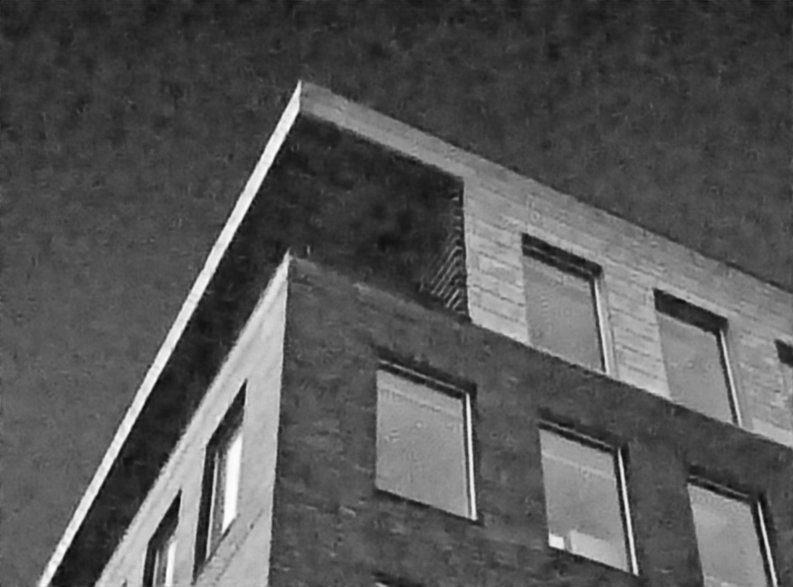

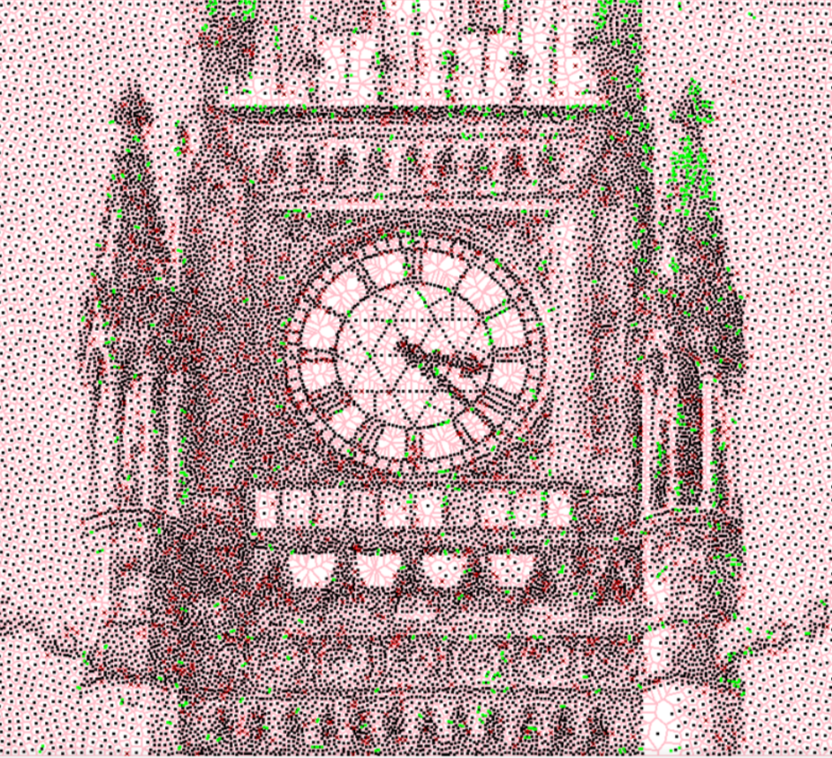
Method
UNet-like architecture
Stippling image
Reconstructed image
MSE loss
WLBG stippling
GT grayscale image

Slide 15
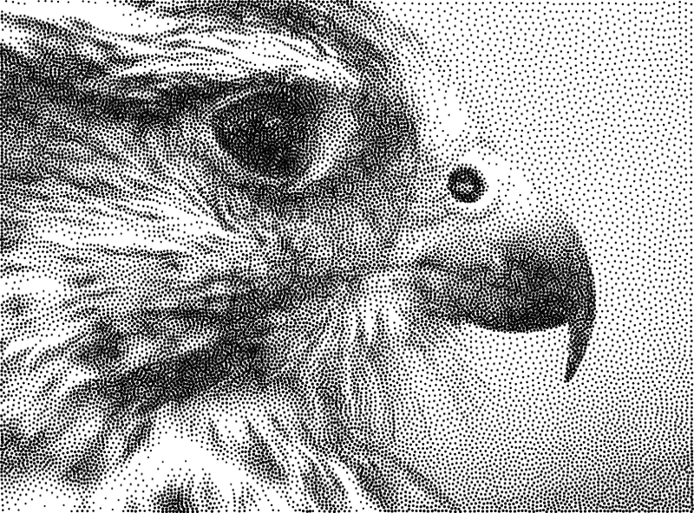
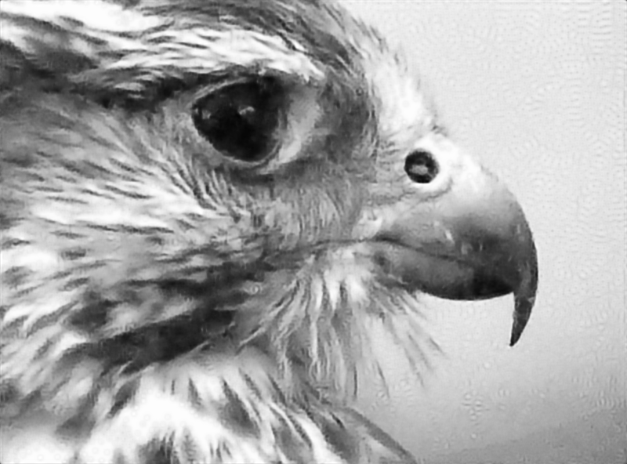
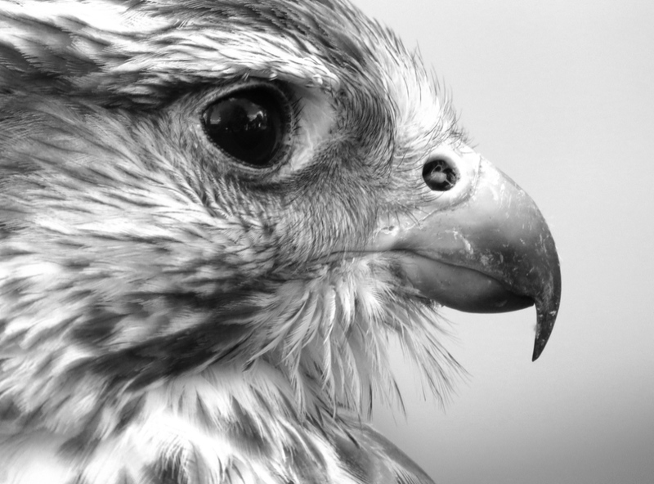
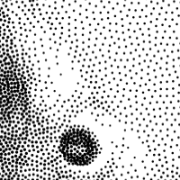
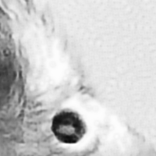
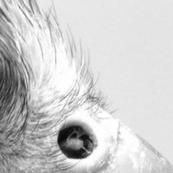
Result
WLBG Stippling image
Reconstructed image
Ground Truth

Slide 16
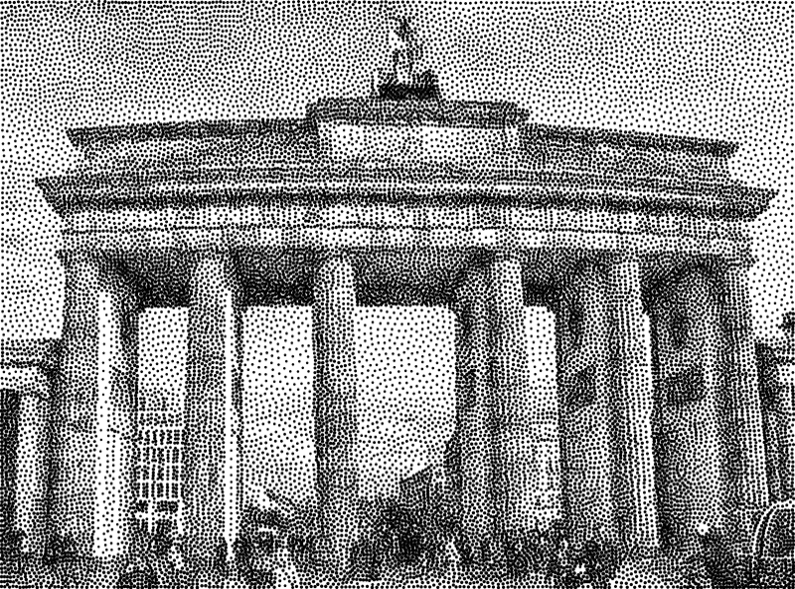
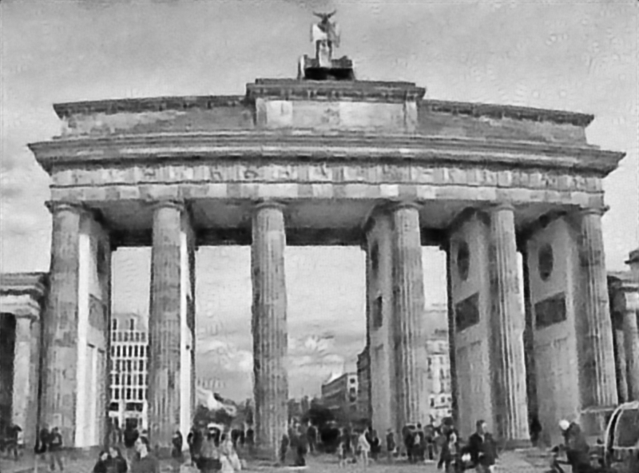
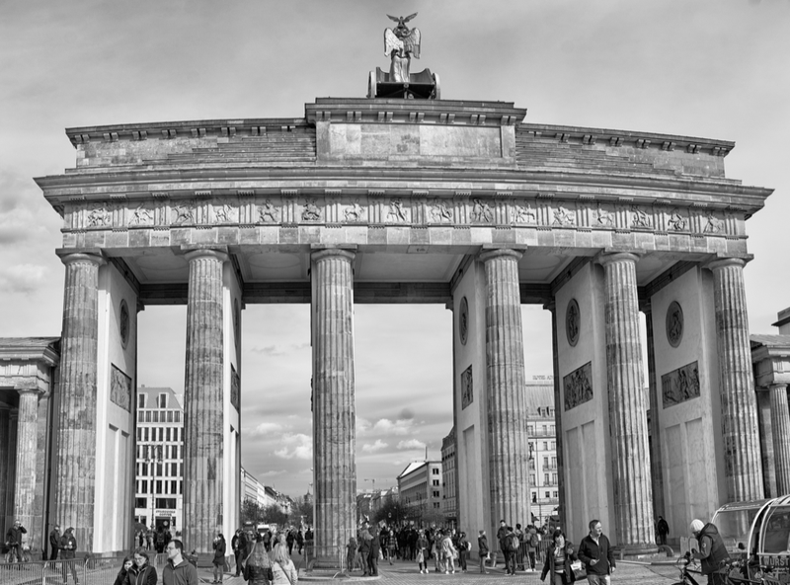
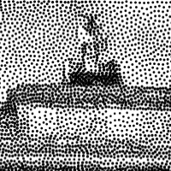
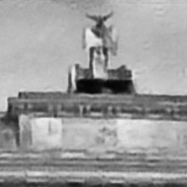

Result
WLBG Stippling image
Reconstructed image
Ground Truth

Slide 17

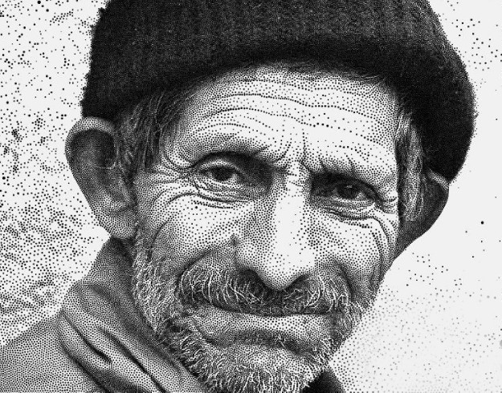
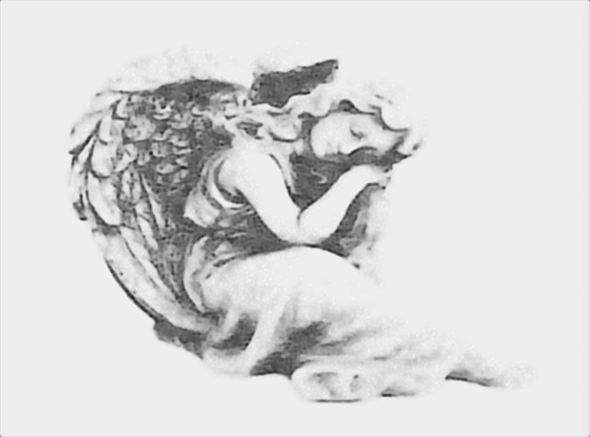
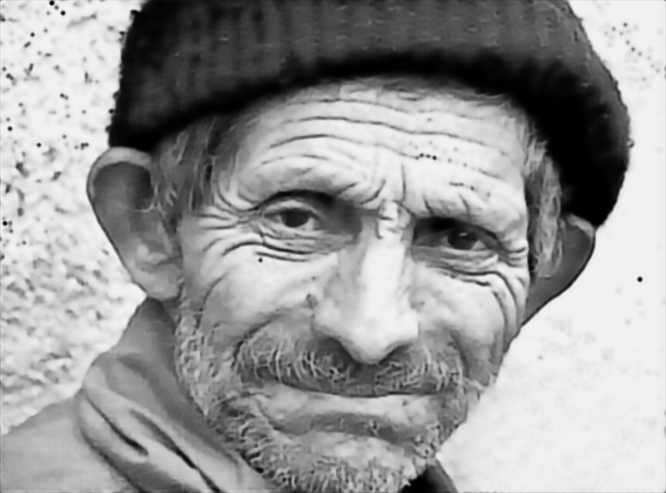
Real-world Stippling Reconstruction
Stippling image
Reconstructed image

Slide 18







Stippling-Reconstruction Iteration
Iteration 1
Iteration 10
Iteration 30
Iteration 50
Reconstructed
Image
Stippling

Slide 19


